Slide 1
Data Pre-processing

Slide 2
Data Pre-processing
Data preprocessing is a data mining technique which is used to transform the raw data in a useful and efficient format.
Steps Involved in Data Preprocessing:
1. Data Cleaning: The data can have many irrelevant and missing parts. To handle this part, data cleaning is done. It involves handling of missing data, noisy data etc.
(a) Missing Data: This situation arises when some data is missing in the data. It can be handled in various ways. Some of them are:
Ignore the tuples: This approach is suitable only when the dataset we have is quite large and multiple values are missing within a tuple.
Fill the Missing values: There are various ways to do this task.
fill the missing values manually
Fill it automatically
A global constant Unknown a new class
by central tendency attribute mean or median
Use the most probable value.

Slide 3
Data Pre-processing
(b). Noisy Data: Noisy data is a meaningless data that can’t be interpreted by machines. It can be generated due to faulty data collection, data entry errors etc. It can be handled in following ways :
Binning: Binning methods smooth a sorted data value by consulting its “neighborhood,”that is, the values around it. The sorted values are distributed into a number of “buckets,” or bins. Because binning methods consult the neighborhood of values, they perform local smoothing.
Regression: Data smoothing can also be done by regression, a technique that conforms data values to a function.
Outlier analysis: Outliers may be detected by clustering, for example, where similar values are organized into groups, or “clusters.”

Slide 4
Data Pre-processing
Data integration
•Combines data from multiple sources into a coherent store
•Integrate metadata from different sources
•Entity identification problem:
Identify real world entities from multiple data sources,
e.g., Bill Clinton = William Clinton
•Detecting and resolving data value conflicts
For the same real world entity, attribute values from different sources are different
•Possible reasons: different representations, different scales,
e.g., rupee vs. British units
Handling Redundancy in data
Redundant data occur often when integration of multiple databases
•Object identification: The same attribute or object may have different names in different databases
•Derivable data: One attribute may be a “derived” attribute in another table, e.g., annual revenue
•Redundant attributes: may be able to be detected by correlation analysis and covariance analysis
•Careful integration of the data from multiple sources may help reduce/avoid redundancies and inconsistencies and improve mining speed and quality

Slide 5
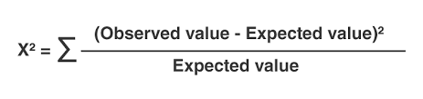
Correlation Analysis (Nominal data)
The Chi-square test of independence tests if there is a significant relationship between two categorical variables. The test is comparing the observed observations to the expected observations. The data is usually displayed in a cross-tabulation format with each row representing a category for one variable and each column representing a category for another variable.
The H0 (Null Hypothesis): There is no relationship between variable one and variable two.
The H1 (Alternative Hypothesis): There is a relationship between variable 1 and variable 2.
If the p-value is significant, you can reject the null hypothesis and claim that the findings support the alternative hypothesis.
(chi-square) test
• The larger the value, the more likely the variables are related
• The cells that contribute the most to the value are those whose actual count is very different from the expected count

Slide 6
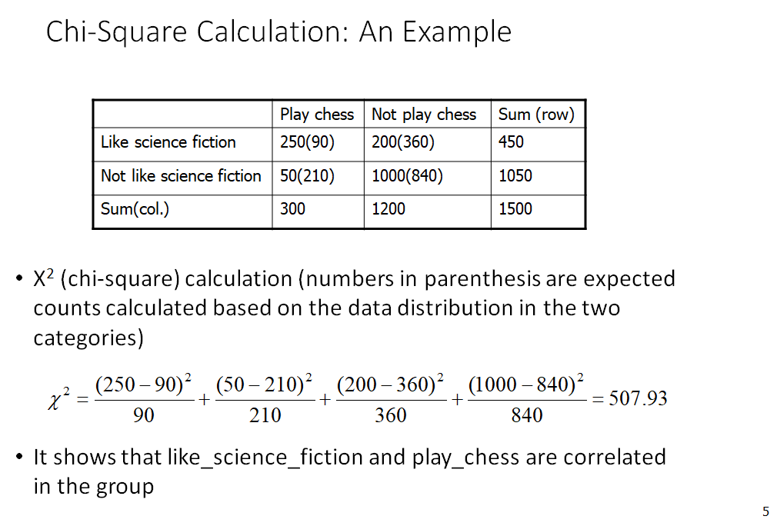
(chi-square) test
•
(chi-square) test

Slide 7
(chi-square) test

Slide 8
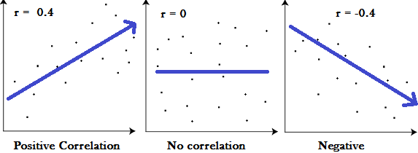
Correlation Analysis
In correlation analysis, we estimate a sample correlation coefficient, more specifically the Pearson Product Moment correlation coefficient.
The sample correlation coefficient, denoted r,
ranges between -1 and +1 and quantifies the direction and strength of the linear association between the two variables.
A “0” means there is no relationship between the variables at all, while -1 or 1 means that there is a perfect negative or positive correlation.
The magnitude of the correlation coefficient indicates the strength of the association.

Slide 9

Pearson’s Correlation
Pearson’s Correlation Coefficient formula is as follows,
Where,
r = Pearson Coefficient
n= number of tuples
∑xy = sum of products
∑x = sum of the x scores
∑y= sum of the y scores
∑x2 = sum of the squared x scores
∑y2 = sum of the squared y scores
Subject | Age X | Glucose level Y | X*y | X*x | Y*y
1 | 43 | 99
2 | 21 | 65
3 | 25 | 79
4 | 42 | 75
5 | 57 | 87
6 | 59 | 81

Slide 10
Pearson’s Correlation
GE X | GLUCOSE LEVEL Y | XY | X² | Y²
1 | 43 | 99 | 4257 | 1849 | 9801
2 | 21 | 65 | 1365 | 441 | 4225
3 | 25 | 79 | 1975 | 625 | 6241
4 | 42 | 75 | 3150 | 1764 | 5625
5 | 57 | 87 | 4959 | 3249 | 7569
6 | 59 | 81 | 4779 | 3481 | 6561
Σ | 247 | 486 | 20485 | 11409 | 40022
From our table:
Σx = 247
Σy = 486
Σxy = 20,485
Σx² = 11,409
Σy² = 40,022
n= 6
The correlation coefficient =
6(20,485) – (247 × 486) / [√[[6(11,409) – (247²)] × [6(40,022) – 486²]]]
= 0.5298

Slide 11
Data Reduction
Data reduction: Obtain a reduced representation of the data set that is much smaller in volume but yet produces the same (or almost the same) analytical results
Why data reduction? — A database/data warehouse may store terabytes of data. Complex data analysis may take a very long time to run on the complete data set.
Dimensionality reduction Strategies include
Dimensionalality reduction
Numerosity reduction
Data compression
Dimensionality reduction
Avoid the curse of dimensionality
Help eliminate irrelevant features and reduce noise
Reduce time and space required in data mining
Allow easier visualization

Slide 12
Attribute Subset Selection
Another way to reduce dimensionality of data
Redundant attributes
Duplicate much or all of the information contained in one or more other attributes
E.g., purchase price of a product and the amount of sales tax paid
Irrelevant attributes
Contain no information that is useful for the data mining task at hand
E.g., students' ID is often irrelevant to the task of predicting students' GPA
12
Notes:
12

Slide 13
Method of Attribute Selection
1.Stepwise forward selection: The procedure starts with an empty set of attributes as
the reduced set. The best of the original attributes is determined and added to the
reduced set. At each subsequent iteration or step, the best of the remaining original
attributes is added to the set.
2. Stepwise backward elimination: The procedure starts with the full set of attributes.
At each step, it removes the worst attribute remaining in the set.
4. Decision tree induction: Decision tree algorithms (e.g., ID3, C4.5, and CART) were
originally intended for classification. Decision tree induction constructs a flowchart-
like structure where each internal (nonleaf) node denotes a test on an attribute, each
branch corresponds to an outcome of the test, and each external (leaf) node denotes a
class prediction. At each node, the algorithm chooses the “best” attribute to partition
the data into individual classes.
13
Notes:
13

Slide 14
Data Reduction 2: Numerosity Reduction
Reduce data volume by choosing alternative, smaller forms of data representation
Parametric methods (e.g., regression)
Assume the data fits some model, estimate model parameters, store only the parameters, and discard the data (except possible outliers)
Regression analysis: A collective name for techniques for the modeling and analysis of numerical data consisting of values of a dependent variable (also called response variable or measurement) and of one or more independent variables (aka. explanatory variables or predictors)
The parameters are estimated so as to give a "best fit" of the data
Linear regression
Often uses the least-square method to fit the line
Data modeled to fit a straight line
Multiple regression
Allows a response variable Y to be modeled as a linear function of multidimensional feature vector
Log-linear model
Approximates discrete multidimensional probability distributions
Y1
Y1’
y = x + 1
X1
x
Used for prediction (including forecasting of time-series data), inference, hypothesis testing, and modeling of causal relationships
14
Notes:
14

Slide 15
Data Reduction 2: Numerosity Reduction
Non-Parametric methods: for storing reduced representations of the data includes
Histograms: Uses binning to approximate data distribution
Clustering: partitions into groups
Sampling :uses large number of smaller samples
Data cube aggregation: uses summarization
Ex:months are aggregated to years

Slide 16
Data Transformation
A function that maps the entire set of values of a given attribute to a new set of replacement values s.t. each old value can be identified with one of the new values
Methods
Smoothing: Remove noise from data
Attribute/feature construction
New attributes constructed from the given ones
Aggregation: Summarization, data cube construction
Normalization: Scaled to fall within a smaller, specified range
min-max normalization
z-score normalization
normalization by decimal scaling
Discretization: Concept hierarchy climbing
16
Notes:
16

Slide 17
Normalization
Min-max normalization: to [new_min_{A}, new_max_{A}]
Ex. Let income range $12,000 to $98,000 normalized to [0.0, 1.0]. Then $73,600 is mapped to
Z-score normalization (μ: mean, σ: standard deviation):
Ex. Let μ = 54,000, σ = 16,000. Then
Normalization by decimal scaling
Where j is the smallest integer such that Max(|ν’|) < 1
17
Notes:
17

Slide 18
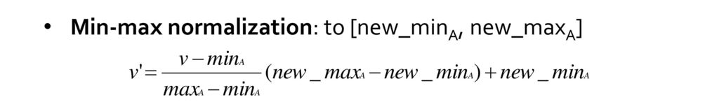
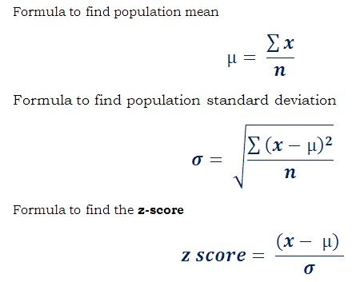
Normalization
Min-max normalization: to [new_minA, new_maxA]
Z-score normalization(μ: mean, σ: standard deviation): Normalization

Slide 19
Concept Hierarchy Generation for Nominal Data
Specification of a partial/total ordering of attributes explicitly at the schema level by users or experts
street < city < state < country
Specification of a hierarchy for a set of values by explicit data grouping
{Urbana, Champaign, Chicago} < Illinois
Specification of only a partial set of attributes
E.g., only street < city, not others
Automatic generation of hierarchies (or attribute levels) by the analysis of the number of distinct values
E.g., for a set of attributes: {street, city, state, country}
19
Notes:
19

Slide 20
Automatic Concept Hierarchy Generation
Some hierarchies can be automatically generated based on the analysis of the number of distinct values per attribute in the data set
The attribute with the most distinct values is placed at the lowest level of the hierarchy
Exceptions, e.g., weekday, month, quarter, year
country
15 distinct values
province_or_ state
365 distinct values
city
3567 distinct values
street
674,339 distinct values
20
Notes:
20

